Slide 1
Android Mobile Botnet Detection
Vidyavardhini’s College of Engineering & Technology
K.T. Marg, Vartak College Campus, Vasai Rd, Vasai-Virar, Maharashtra 401202
Department of Artificial Intelligence & Data Science
Group No:
Chetan Sapkal
Yash Patil
Shubhamkar Patra
Date: 2/02/2023

Slide 2
Abstract
Android Mobile Botnet Detection
A botnet is a widely spreading malware among mobile applications which is dangerous to mobile apps. Nowadays developers are widely using malicious software for fast development and good results, this leads to the spreading of botnet malware. A botnet mainly aims to hack the entire system and abduct the details of the user. By applying the proposed methodology and algorithms for the detection of botnets. By applying the Machine learning algorithm to the predefined datasets and got the conclusion of successfully testing against the dataset, and detecting some botnet-infected apps.

Slide 3
Summary of Research Paper-1
Title of Paper :DeDroid: A Mobile Botnet Detection Approach Based on Static Analysis.
A botnet is a network of computers that are affected by botnet malware and remotely controlled by the hacker. The nature of a botnet is to change continuously when moving from one system to another. India is the largest country which are using various applications for growing in the IT industries. According to the base paper [10], the work-related to the mobile botnet detection approach. The approach which was built in this paper DeDriod. DeDriod is for investigating the properties of mobile botnets for classification and detection.

Slide 4
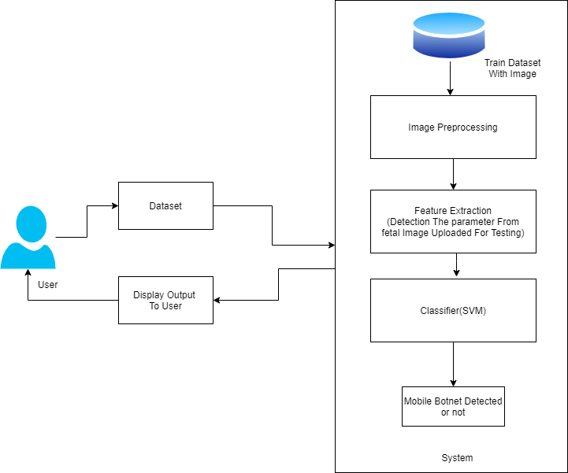
Flow chart of the System

Slide 5
Problem Statement:
Our proposed botnet detection system is implemented as an SVM-based model that is trained on 342 static app features to distinguish between botnet apps and normal apps.
However, because of the recent information explosion, information security has become a crucial topic, even in relation to the IoT.

Slide 6
Conclusion
Botnets are a Dangerous evolution in the malware world. They are being used to damage systems, steal information, and Comprise Systems. They are hard to detect and eliminate, so we will build a System that is Useful to detect Mobile Botnets.

Slide 7
References
Karim, Ahmad & Salleh, Rosli & Shah, Syed. (2015). DeDroid: A Mobile Botnet Detection Approach Based on Static Analysis. 10.1109/UIC-ATCScalCom-CBDCom-IoP.2015.240.

